Slide 1
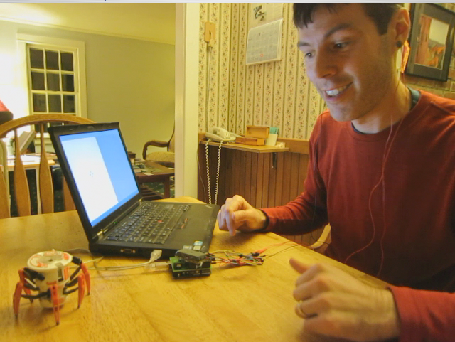
Controlling Robots with My Mind
PC for Visual
Stimulation
EEG
Electrodes
PC for EEG
Processing
Hex Bug
Battle Spider
Electrode
Wires
OpenBCI,
Arduino,
USB to PC
Hex Bug
IR Remote
(Hacked)

Slide 2
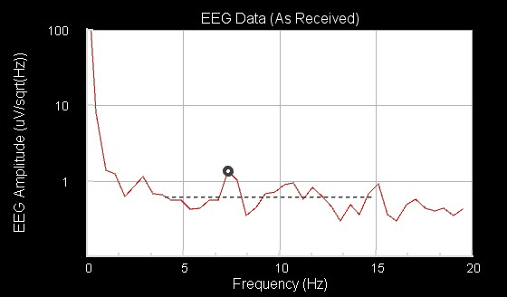


fs=250 Hz
N=512
7.5 Hz
“Turn Left”
fs=250 Hz
N=512
10 Hz
“Forward”
fs=250 Hz
N=512
5.0 Hz
“Turn Right”

Slide 3

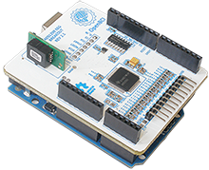
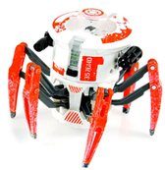


OpenBCI
+ Arduino
EEG
Electrodes
PC
My
Head
EEG
Processing
Decide
Action
Software
(on the PC)
Hex Bug
Remote
Hex Bug
Robot

Slide 4

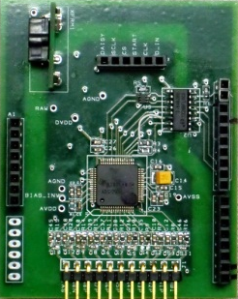
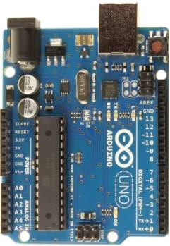


Electrodes
OpenBCI
Arduino
Computer
Hex Bug
Remote
Hex Bug

Slide 5
EEG Processing
Find Max Value
(4-15 Hz)
Frequency of Max Value
Receive Data from OpenBCI
Compute Spectrum
(FFT)
Decide
Command
for Robot
Calculate Ave Value
(4-15 Hz)
Calculate SNR of Max Value
Decide Command for Robot
Frequency and SNR of Spectral Peak
Is SNR
> 6 dB?
If Freq
4.5-6.5 Hz:
“Turn Right”
Yes
Yes
Issue
“Fire!”
No
Yes
If Freq
6.5-8.5 Hz:
“Turn Left”
Yes
Is This a New Command?
Issue “Left”, “Right”, or “Forward”
No
If Freq
8.5-12 Hz:
“Forward”
Yes
Do Not Issue a Command
No

